Slide 1
Local histogram processing
The histogram processing methods mentioned up to now are global transformations where:
Function is designed according to the gray-level distribution over an entire image
Global transformation methods may not be suitable for enhancing details over small areas (where number of pixels may have negligible influence on designing the global transformation function)
CUI, Lahore Campus -- CSC 331: Digital Image Processing -- © Dr. Usama Ijaz Bajwa

Slide 2
Local histogram processing
Implementation steps
1: Define a square or rectangular neighborhood (block), compute the histogram in the local block
2: Generate the transformation function by histogram equalization and perform the gray level mapping for each pixel
3: Move the center of the block to an adjacent pixel location and repeat the procedure
Note
If utilizing non-overlapping region shift, the processed image usually has an undesirable checkerboard effect
CUI, Lahore Campus -- CSC 331: Digital Image Processing -- © Dr. Usama Ijaz Bajwa

Slide 3

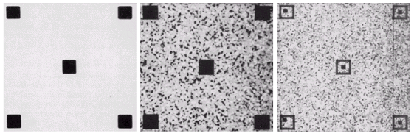
Local histogram processing - example
Result of Global Histogram Equalization
Result of local Histogram Equalization
Original Image
CUI, Lahore Campus -- CSC 331: Digital Image Processing -- © Dr. Usama Ijaz Bajwa

Slide 4
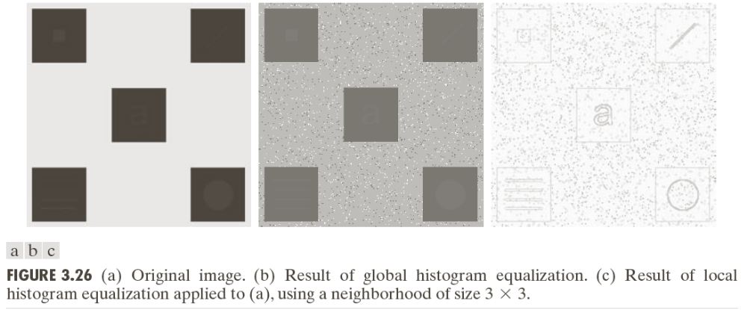
Local histogram processing - example
CUI, Lahore Campus -- CSC 331: Digital Image Processing -- © Dr. Usama Ijaz Bajwa

Slide 5
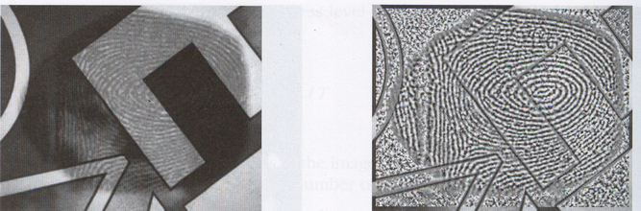
Local histogram processing - example
Original Image
Result of local Histogram Equalization using 9x9 window
CUI, Lahore Campus -- CSC 331: Digital Image Processing -- © Dr. Usama Ijaz Bajwa

Slide 6
Local enhancement using statistical parameters from histogram
Local enhancement can be based on statistical properties of the gray levels in a block instead of using full histogram
Examples:
Mean gives the average intensity of the image
Variance (σ²) and its square root the standard deviation gives the deviation of intensities on average from the mean value (measure of contrast)
CUI, Lahore Campus -- CSC 331: Digital Image Processing -- © Dr. Usama Ijaz Bajwa

Slide 7
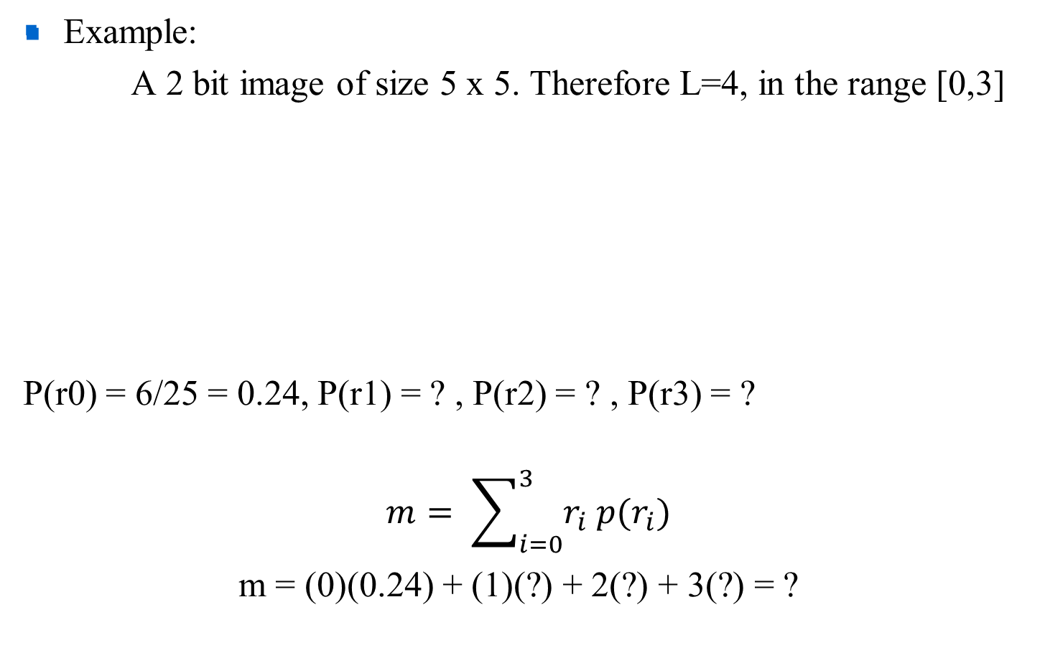
Local enhancement using statistical parameters
0 | 0 | 1 | 1 | 2
1 | 2 | 3 | 0 | 1
3 | 3 | 2 | 2 | 0
2 | 3 | 1 | 0 | 0
1 | 1 | 3 | 2 | 2
CUI, Lahore Campus -- CSC 331: Digital Image Processing -- © Dr. Usama Ijaz Bajwa

Slide 8
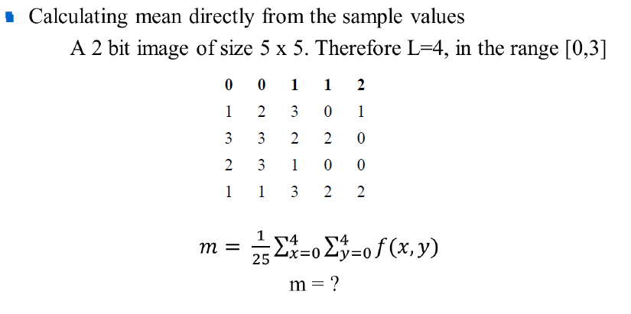
Local enhancement using statistical parameters
CUI, Lahore Campus -- CSC 331: Digital Image Processing -- © Dr. Usama Ijaz Bajwa

Slide 9
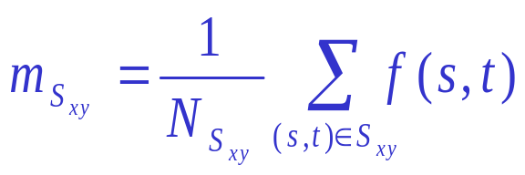
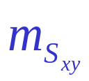
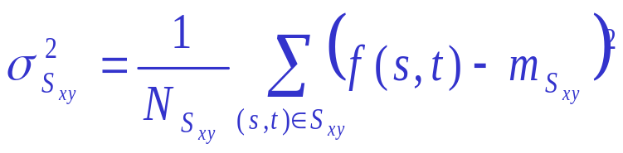
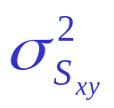

Local enhancement using statistical parameters
S_{xy} : a neighborhood (subimage) of size N_{Sxy}; a block centered at (x,y)
: gray-level mean in S_{xy}
: gray-level variance in S_{xy}
: standard deviation, square root of variance
M_{G} : global mean of f(x,y)
D_{G} : global standard deviation of f(x,y)
CUI, Lahore Campus -- CSC 331: Digital Image Processing -- © Dr. Usama Ijaz Bajwa

Slide 10
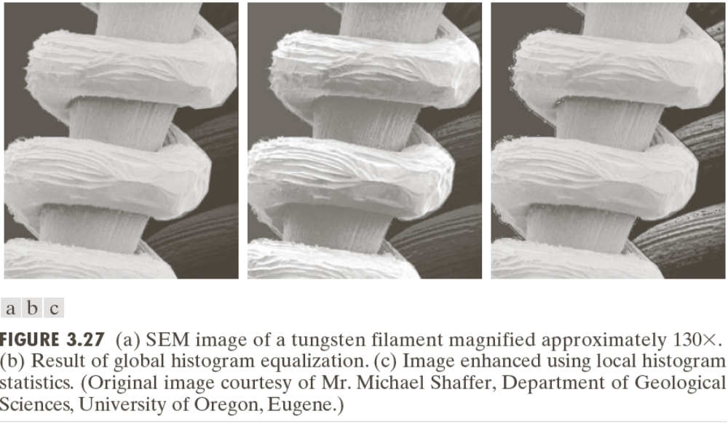
Local enhancement using statistical parameters
CUI, Lahore Campus -- CSC 331: Digital Image Processing -- © Dr. Usama Ijaz Bajwa

Slide 11
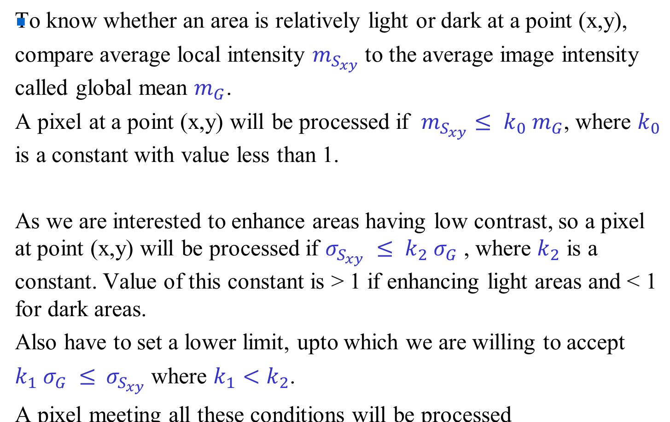
Local enhancement using statistical parameters
CUI, Lahore Campus -- CSC 331: Digital Image Processing -- © Dr. Usama Ijaz Bajwa

Slide 12
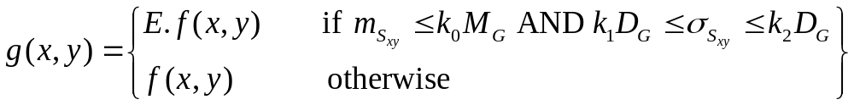
Local enhancement using statistical parameters
Using them in defining ranges for different transfer functions for example
where E, k₀, k₁, k₂, are specified parameters
CUI, Lahore Campus -- CSC 331: Digital Image Processing -- © Dr. Usama Ijaz Bajwa

Slide 13
Local enhancement using statistical parameters
CUI, Lahore Campus -- CSC 331: Digital Image Processing -- © Dr. Usama Ijaz Bajwa

Slide 14
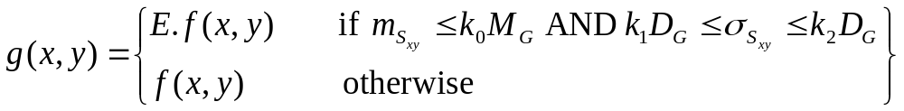
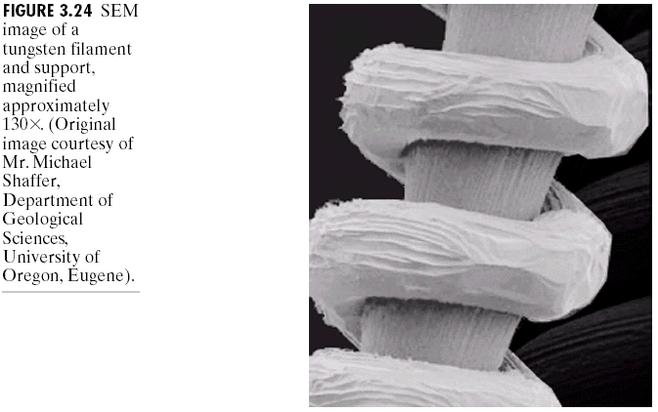
Local enhancement using statistical parameters
Defining ranges for different transformation functions
CUI, Lahore Campus -- CSC 331: Digital Image Processing -- © Dr. Usama Ijaz Bajwa

Slide 15
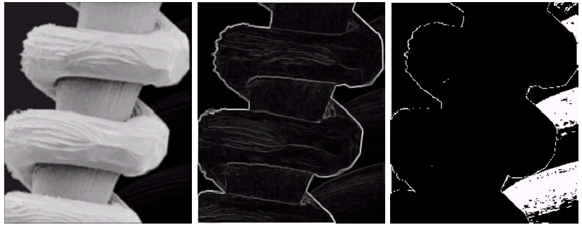
Local enhancement using statistical parameters
E = 4.0, k₀ = 0.4, k₁ = 0.02, and k₂ = 0.4,
CUI, Lahore Campus -- CSC 331: Digital Image Processing -- © Dr. Usama Ijaz Bajwa

Slide 16
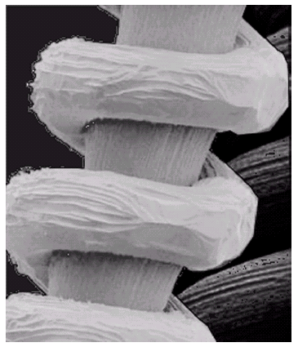
Local enhancement using statistical parameters
Input microscopic image
Enhanced output image
CUI, Lahore Campus -- CSC 331: Digital Image Processing -- © Dr. Usama Ijaz Bajwa

Slide 17
Reading Assignment
Chapter 2 and Chapter 3 (Complete, except the topics left)
CUI, Lahore Campus -- CSC 331: Digital Image Processing -- © Dr. Usama Ijaz Bajwa

